Slide 1
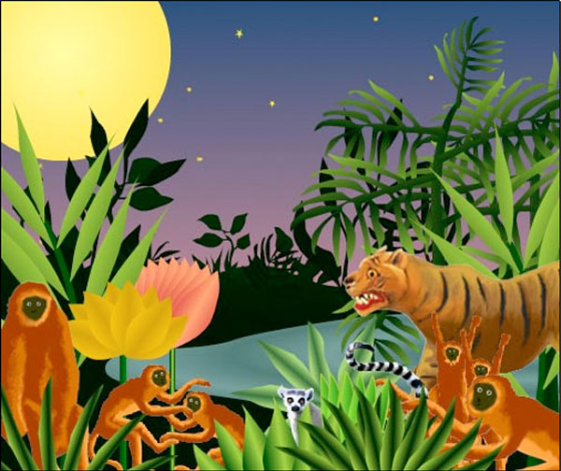
King & King & Family
by
Linda de Haan &
Stern Nijland

Slide 2
Listen to the story carefully

Slide 3
Name the animal families that you met in the jungle…

Slide 4
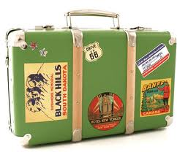
Opening the suitcase…
How do you feel when you come back from holiday and unpack?
What would you do if you found a little girl in your suitcase?
What would you say to the suitcase child?
What does she tell you?

Slide 5
Opening the suitcase…
What is ‘adoption’?
Who is allowed to adopt children?
What sort of things do you think you will have to consider if you were adopting a child?

Slide 6
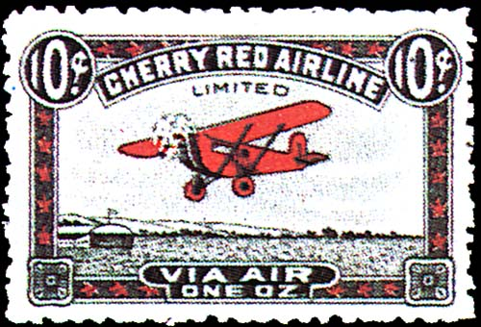
Postcard

Slide 7
King & King’s jungle map by …………………………………..

Slide 8
Packing list for the jungle
………………………………………… ……………………………………………
………………………………………… ……………………………………………
………………………………………… ……………………………………………
………………………………………… ……………………………………………
………………………………………… ……………………………………………
………………………………………… ……………………………………………

