Slide 1
Colours of the Rainbow

Slide 2
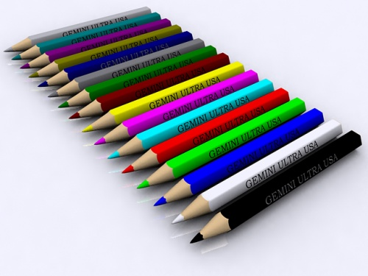
Can you name these colours?

Slide 3
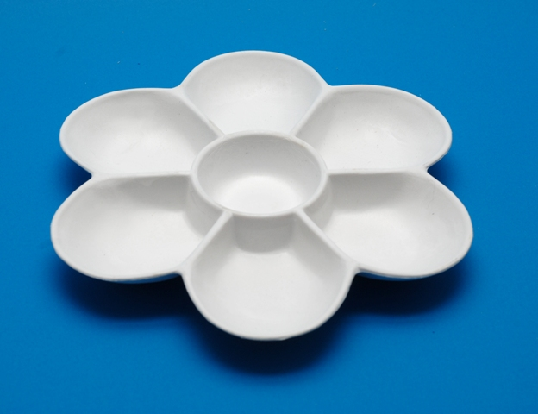
What is your favourite colour?
Notes:
Use your interactive whiteboard to add colours to this empty palette

Slide 4
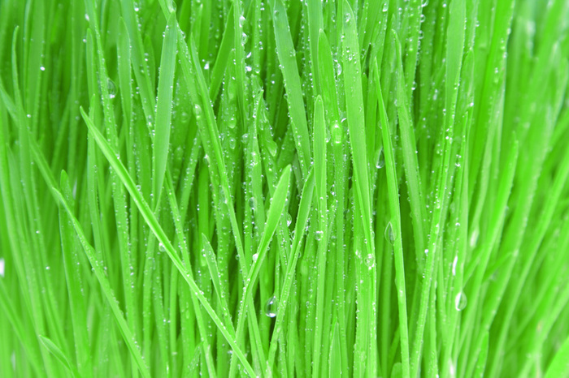
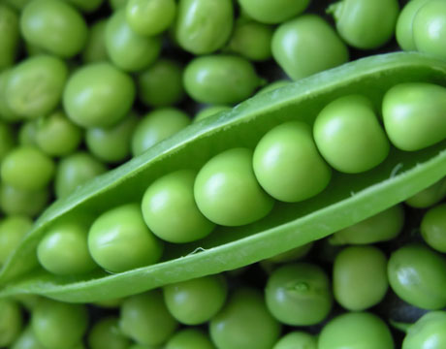
Green is for….
grass…
go…
peas…

Slide 5
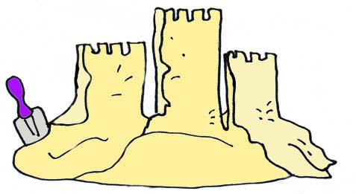
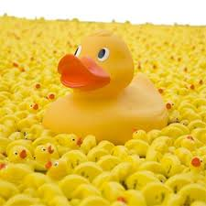
Yellow is for….
sun…
sand…
ducks…

Slide 6
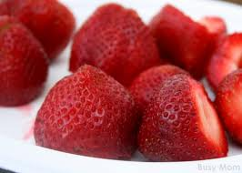
Red is for….
roses…
strawberries…
and … ?
Notes:
Children to identify red objects

Slide 7
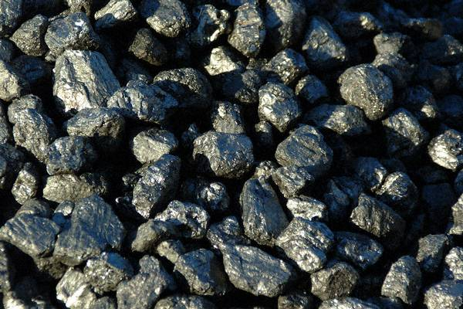
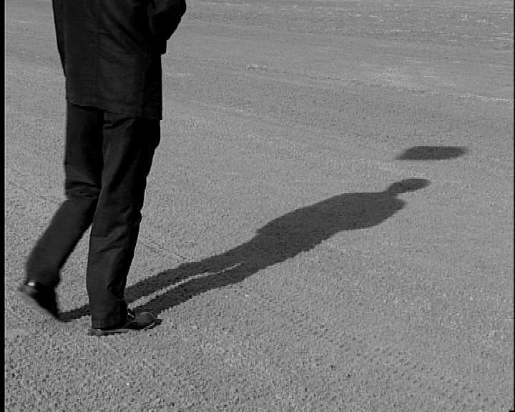
Let’s look at some more…
Black is for…
coal…
shadows…
and… ?
Notes:
Children to identify black objects

Slide 8
Colours of the Rainbow
2

Slide 9
Can you remember the colours we looked at before?

Slide 10
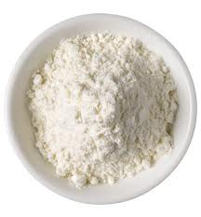
White is for…
snow…
salt…
and… ?
?
Notes:
Children to identify white objects- hopefully weddings

Slide 11
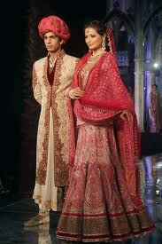
But not always weddings.

Slide 12
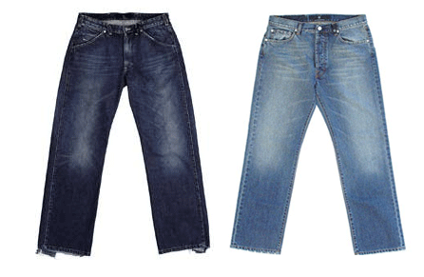
Blue is for…
sky…
jeans…
and… ?
Notes:
Children to identify blue- hopefully ‘for boys’

Slide 13
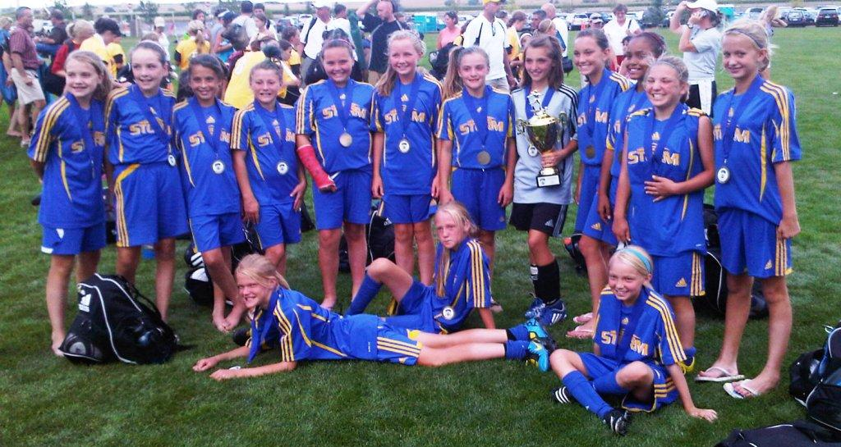
But not always for boys…

Slide 14
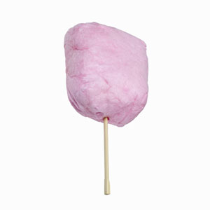
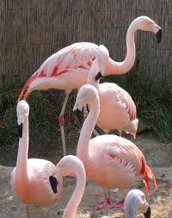
Pink is for…
candy floss…
flamingoes…
and…?
Notes:
Children to identify pink objects- hopefully ‘for girls or Barbie’ Try telling the French Rugby team that!

Slide 15
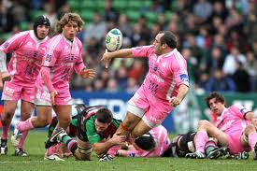
But not always for girls…

