Slide 1
Curriculum links
Nuclear fusion
Renewable energy
Energy stores
Binding energy
Gatsby Benchmark 4
Please note that these resources have been developed with support from teachers, in line with the England/Wales science curriculum.
Notes:
These slides have blue font on them to aid accessibility. You may wish to change the font colour or background according to your students’ needs.

Slide 2
Using this resource
These careers profiles helps you link what you are teaching to a real life context, raises awareness of different careers available to your students whilst usualising LGBTQ+ people and providing role models for all students.
This resource is to be used when teaching or revising this topic and does not solely need to be used during LGBT+ History Month or Pride Month.
This can be used as a starter, homework activity or part of the main activity in your lesson.

Slide 3
Using this resource
This resource also provides a framework on how you could include a link to the curriculum through practice questions and show a diverse range of different people working in STEM.
At the end of this slide deck, there is a glossary of LGBTQ+ terms that you may find helpful for your conversations with your students and colleagues. This is not an exhaustive list of all LGBTQ+ identities and any mentioned in this specific slide deck are highlighted in bold and underlined.

Slide 4
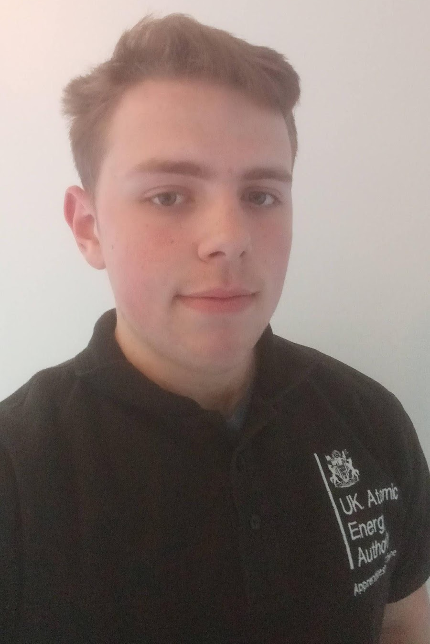
Felix Warren (He/Him)
I am an engineering apprentice and soon to be technician working on the high voltage power supplies system for Culham Science Centre’s main fusion reactor.
I left college after AS-levels in 2017 to join the UK Atomic Energy Authority as an apprentice, this course lasts 4 years finishing in 2021.
Notes:
The flag with pink, yellow and blue stripes is the pansexual flag. Refer to the glossary section for the definition of pansexual.

Slide 5
What is an apprenticeship?
An apprenticeship involves working in a job whilst gaining qualifications (for free!). You will learn and train for a specific job and at least 20% of your working hours will involve studying at a college, university or with a training provider.
There are different levels for apprenticeships, including university degree level, and can vary in length depending on the level. You can start an apprenticeship at the age of 16.
Notes:
Information and links about apprenticeships here for teachers

Slide 6
Why did I do an apprenticeship?
I decided to do an apprenticeship because find practical, hands on learning to be preferable to traditional university academics. Over a 4 year course I can get fully qualified for the same position offered to post-graduates as well as gain access to bursaries and funds to complete my degree while I work.
During my time as an apprentice I have worked in a half dozen different departments and roles as well as had the opportunity to partake in outreach, communications and recruitment events where I have found I enjoy presenting and talking to people about STEM topics, apprenticeships and the career options available in these areas.
Notes:
Information and links about apprenticeships here for teachers

Slide 7
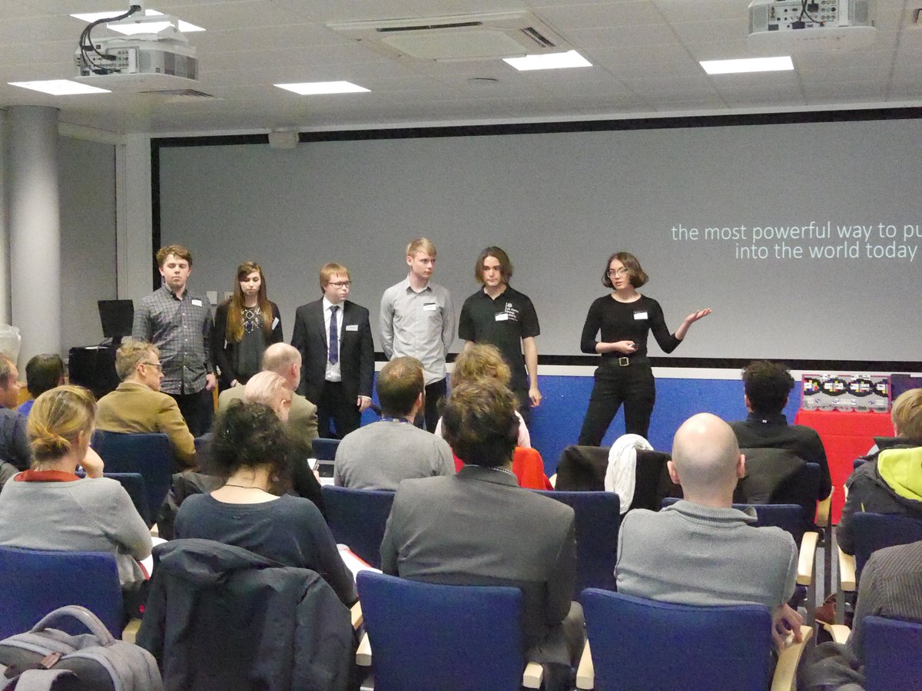
More about Felix
During my career some highlights would be presenting at the 2019 Public Awareness of Research Infrastructure conference where I got to talk about my work with EURO-Fusion as well as my time at the apprentice college where I got to learn a large number of useful engineering skills.
I identify as Pansexual. Outside of work I spend my time gardening, keeping fit and running tabletop RPGs such as Dungeons & Dragons or Cyberpunk2020.

Slide 8
Practice question (KS2)
Felix works at Culham Centre for Fusion Energy. They look into how we can use nuclear fusion in nuclear power centres in order to generate electricity which can be used at home.
Label these different electrical symbols.
M

Slide 9
Practice question (KS2)
Felix works at Culham Centre for Fusion Energy. They look into how we can use nuclear fusion in nuclear power centres in order to generate electricity which can be used at home.
Label these different electrical symbols.
M
Cell
Wire
Bulb
Motor

Slide 10
Practice questions (KS3)
Felix works at Culham Centre for Fusion Energy. They look into how we can use nuclear fusion in nuclear power centres in order to generate electricity which can be used at home. The energy from nuclear fuels is used to turn water into steam, to turn a turbine and then a generator.
Which energy store is emptied when the nuclear fuel reaction takes place?
Which energy store is filled as the water turns into steam?
Through which pathway is the energy transferred to our homes through the National grid?

Slide 11
Practice questions (KS3)
Felix works at Culham Centre for Fusion Energy. They look into how we can use nuclear fusion in nuclear power centres in order to generate electricity which can be used at home.
Answers:
1. Nuclear
2. Thermal
3. Electrical working or work done by an electric current

Slide 12
Practice questions (KS4)
Felix works at Culham Centre for Fusion Energy. They look into how we can use nuclear fusion in nuclear power centres in order to generate electrical energy which can be used at home.
1. What is nuclear fusion?
2. Name somewhere where nuclear fusion occurs.

Slide 13
Practice questions (KS4)
Felix works at Culham Centre for Fusion Energy. They look into how we can use nuclear fusion in nuclear power centres in order to generate electrical energy which can be used at home.
1. It is when two small, light nuclei join together to make one heavy nucleus.
2. The sun (and stars in general)

Slide 14
Practice question 1 (KS5)
Felix works in the nuclear fusion industry. The fusion reaction that takes place in main sequence stars and fusion reactors involves hydrogen fusing to produce helium. At one stage in this process two different hydrogen isotopes form helium and an excess neutron:
H + H He + n
Calculate the energy released in this reaction. Give your answer in MeV. Using information from your data sheet plus the information below:
3
2
4
1
1
1
2
0
Atom | Mass (x 10-27kg)
H | 3.343
H | 5.007
He | 6.645
2
1
3
1
4
2
Notes:
KS3 percentage question

Slide 15
Practice question 1 (KS5)
Mass before: (3.343 + 5.007) x 10⁻²⁷kg
Mass after: (6.645 + 1.675) x 10⁻²⁷kg
Mass defect: 3.00 x 10⁻²⁹kg
E = mc²
E = 3.00 x 10⁻²⁹ x (3 x 10⁸)²
E = 2.7 x 10⁻¹² J = 20.8MeV
Notes:
KS3 percentage question

Slide 16
Practice question 2 (KS5)
Felix works at Culham Centre for Fusion Energy which looks into how we generate electricity using nuclear fusion. One place in which nuclear fusion can take place is in stars. Fusion of hydrogen nuclei forms helium-3 and helium 4. As the temperature rises, they both fuse to produce beryllium-7 with the release of energy in the form of gamma radiation.
Calculate the energy released when helium-3 nucleus fuses with helium-4 nucleus, in J. The table below shows the masses of each nuclei.
Nucleus | Mass/u
Helium-3 | 3.01493
Helium-4 | 4.00151
Berylium-8 | 7.01473
Notes:
KS3 percentage question

Slide 17
Practice question 2 (KS5)
Mass change in u =
7.01473 - 3.01493 - 4.00151 = 1.71 x 10⁻³u
(convert to kg -> x 1.661 x 10⁻²⁷)
Δm = 2.84 x 10⁻³⁰ kg
E = mc²
E = 2.84 x 10⁻³⁰ x (3.00 x 10⁸)²
= 2.55 x 10¹³ (J)
Notes:
KS3 percentage question

Slide 18
Glossary
We are aware that there may be some language and terminology that some may not be as familiar with. You may find it helpful to discuss these terms with your colleagues in order to build your confidence with talking about different identities with your students.
For more information, you can also refer to:
Stonewall’s guidance
The Proud Trust’s Glossary
The ABCs of LGBT by Ash Hardell (book)

Slide 19
Glossary
Ace/asexual: someone who experiences little to no sexual attraction and/or sexual desire.
Bi/bisexual: someone who has romantic and/or sexual attraction towards more than one gender.
Gay: refers to a man who has romantic and/or sexual attraction to men. Some women may prefer to use gay to describe themselves rather than using lesbian. Some non-binary people may also use this term.
Genderqueer: an umbrella term for a gender which may fall outside of, or fall in between, or fluctuate between the binary gender categories of woman and man.
Lesbian: refers to a woman who has romantic and/or sexual attraction towards other women. Some non-binary people may also use this term.
Non-binary: an umbrella term for people whose gender identity fall outside of the woman and man gender binary.
Queer: historically this has been a word been used as a slur. This word was been reclaimed in the 1980s and is used in different ways, e.g. as an umbrella term for people who identify as LGBTQIA+; when an individual prefers a broader term to describe themselves rather than specific identities.
Pansexual: someone who is romantically and/or sexually attracted towards others and is not limited by sex or gender.
Panromantic: someone who is romantically attracted towards others and is not limited by sex or gender.
Trans/transgender: an umbrella term to describe people whose gender is not the same as the sex they were assigned at birth.

